Slide 1
ARRAYS

Slide 2
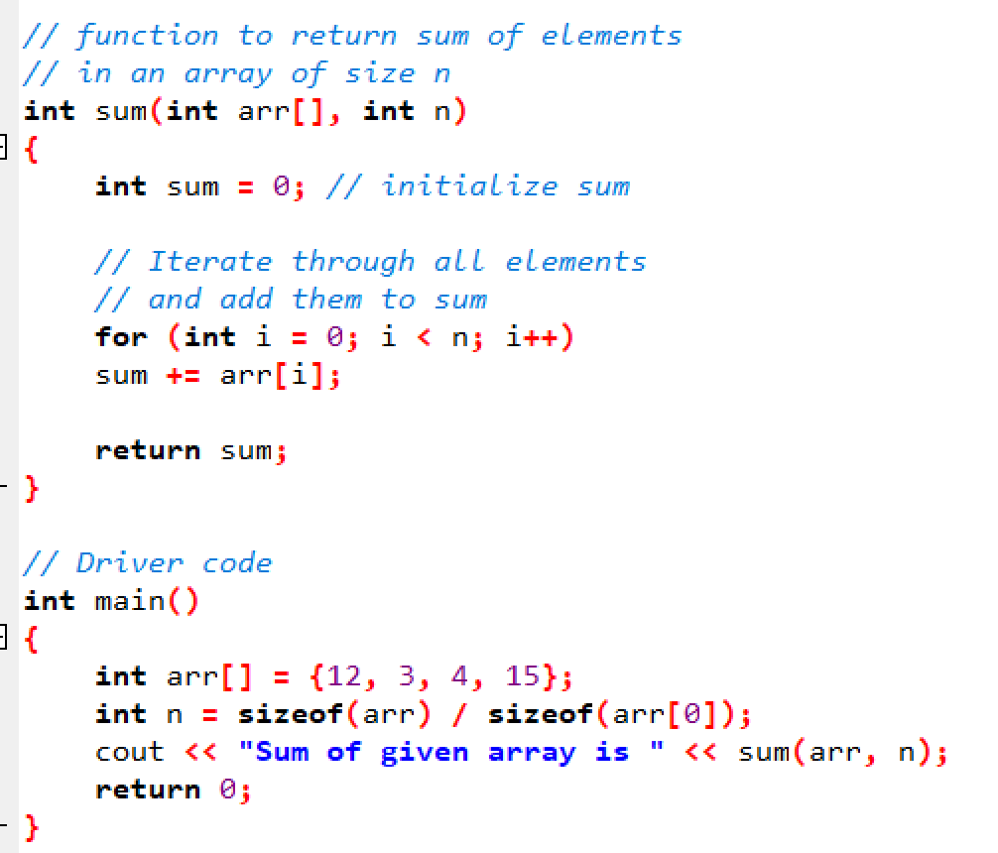
SUM OF ARRAY ELEMENTS

Slide 3
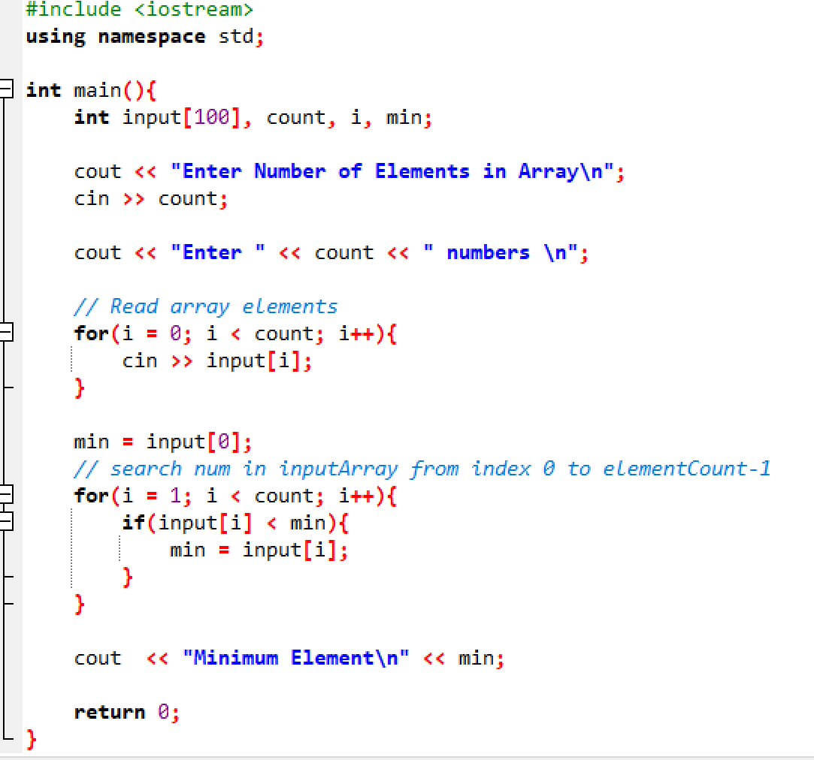
SMALLEST ELEMENT IN THE ARRAY

Slide 4
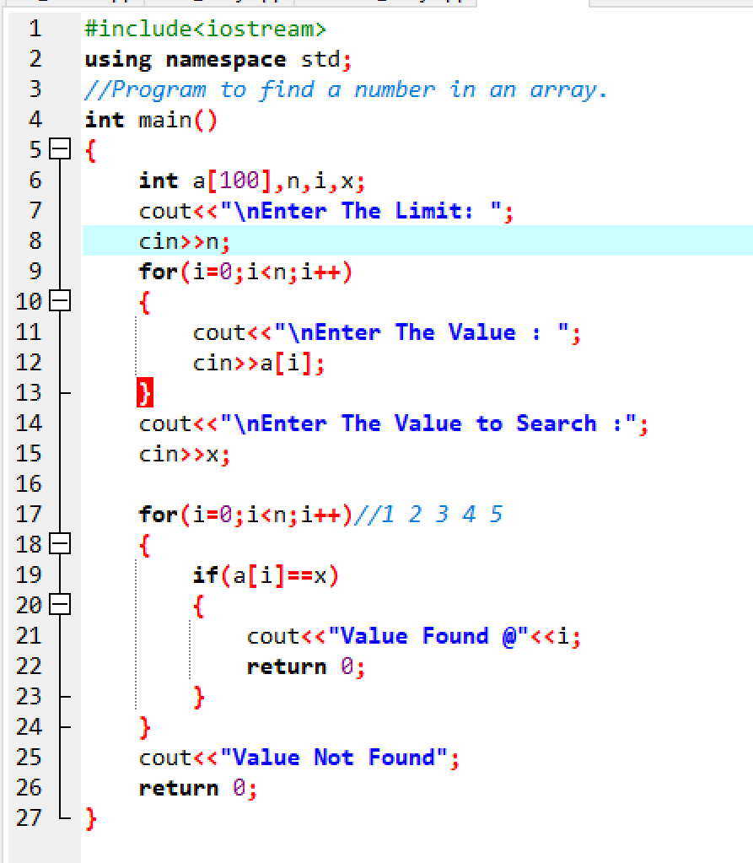
LINEAR SEARCH IN ARRY

Slide 5
Matrix Operations
Equal matrix
Transpose matrix
Symmetry matrix
Skew Symmetry
Identity matrix
Diagonal matrix

Slide 6
Equal Matrix
if(isEqual == 1)
{
printf("\nMatrix A is equal to Matrix B");
}
else
{
printf("\nMatrix A is not equal to Matrix B");
}
isEqual = 1;
for(row=0; row<SIZE; row++)
{
for(col=0; col<SIZE; col++)
{
if(A[row][col] != B[row][col])
{
isEqual = 0;
break;
}
}
}

Slide 7
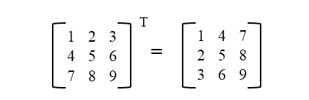
Transpose Matrix
for(row=0; row<MAX_ROWS; row++)
{
for(col=0; col<MAX_COLS; col++)
{
B[col][row] = A[row][col];
}
}

Slide 8
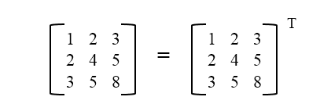
Symmetry matrix
if(x == 1)
{
printf("\nThe Entered Matrix is Not A Symmetric Matrix\n");
}
else
{
printf("\nThe Entered Matrix is A Symmetric Matrix\n");
}
for (i = 0; i < m; i++) {
for( j = 0; j < n; j++) {
if ( i!=j && A[i][j] != A[j][i])
{ x = 1;
break;
}
}
if(x==1)break;
}

Slide 9

Skew Symmetry matrix
for(row = 0; row < a; row++)
{
for(column = 0; column < b; column++)
{
if(row !=column && A[row][column] != -A[column][row])
{
x = 1;
break;
}
}
if(x==1)break;
}
if(x == 1)
{
printf("\nThe Entered Matrix is Not A Skewed Symmetric Matrix\n");
}
else
{
printf("\nThe Entered Matrix is A Skewed Symmetric Matrix\n");
}

Slide 10
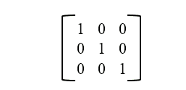
Identity matrix
isIdentity = 0;
for(row=0; row<SIZE; row++)
{
for(col=0; col<SIZE; col++)
{
if(row==col && A[row][col]!=1)
{
isIdentity = 1;
}
else if(row!=col && A[row][col]!=0)
{
isIdentity = 1;
}
}
}

Slide 11
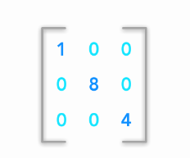
Diagonal matrix
X=1;
for (int i = 0; i < N; i++)
{
for (int j = 0; j < N; j++)
{
if ((i != j) && (mat[i][j] != 0))
{ x=0;
break;
}
}
if(x==1)break;
}

